Slide 1

Time for some Reflection and Next Steps!
https://urly.fi/3BPE
.

Slide 2
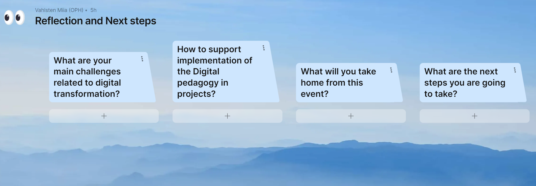
Use PLUS button under the question to start
Use the PLUS button under the question to start
https://urly.fi/3BPE

